Slide 1
‘BRWYDR ABERTAWE’
Dr Huw Griffiths
a
Dr Susan Davis
DARPL

Slide 2
SUT I DDEFNYDDIO’R SLEIDIAU HYN
Defnyddiwch y sleidiau hyn ar y cyd â’r nodiadau i athrawon
Maent wedi’u cynllunio i ysgogi sgwrs ac ymchwil pellach
Dylai athrawon weithio gyda’r dysgwyr i archwilio’r deunyddiau a’u haddasu yn ôl anghenion / oedran y dysgwr ac ati
Mae deunydd darllen pellach / gwybodaeth bellach ar y dudalen nodiadau i athrawon

Slide 3
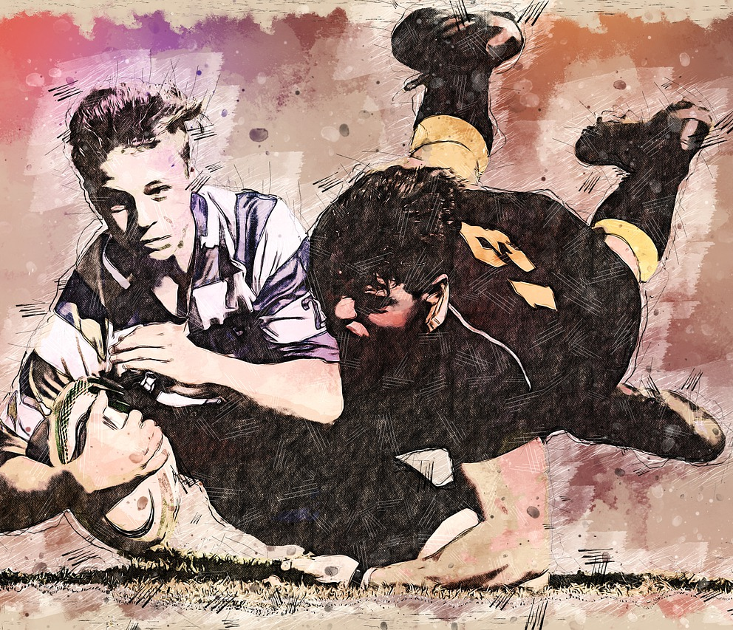
BETH YW’R CYSYLLTIAD RHWNG Y CANLYNOL?
Abertawe, Cymru
Rygbi
Nelson Mandela
Apartheid
De Affrica?

Slide 4
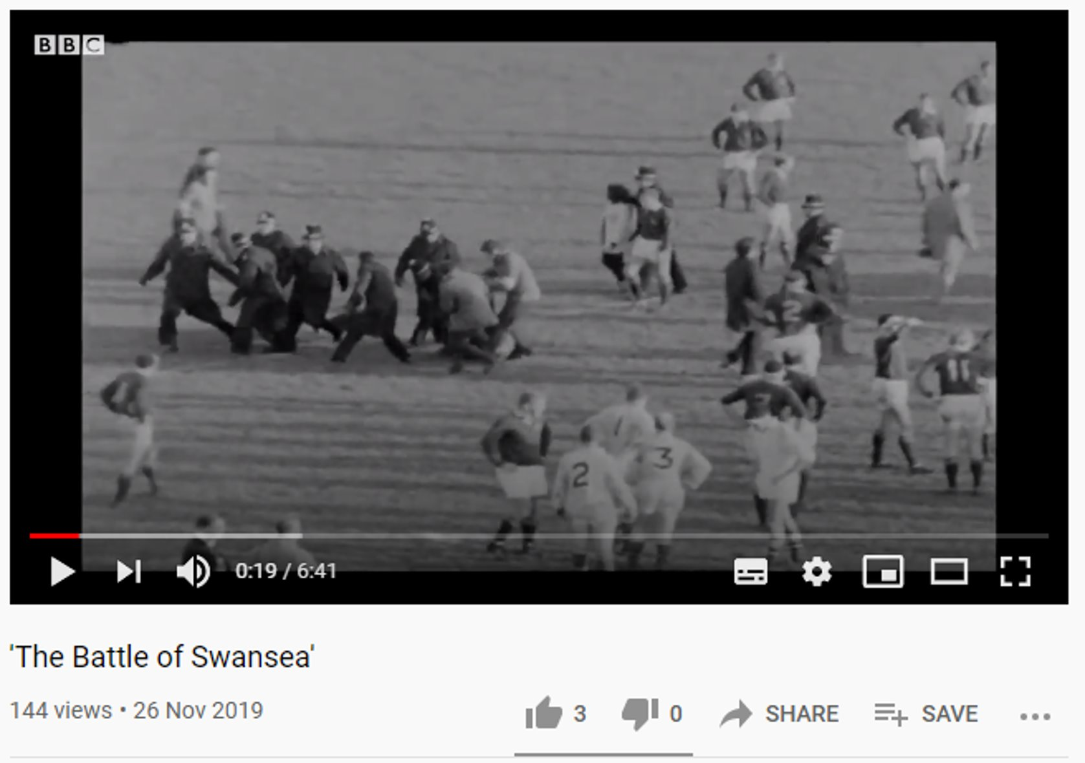
‘BRWYDR ABERTAWE’
Y fideo gan : BBC ar
https://youtu.be/UNg0WI2aOdY

Slide 5
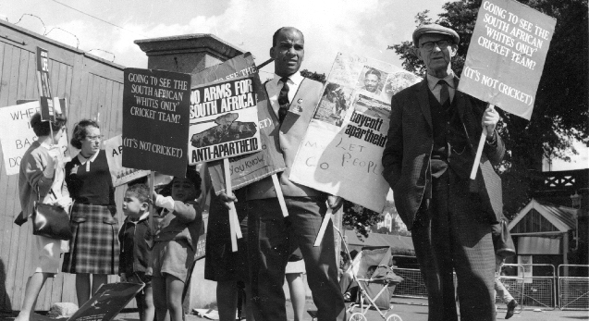
Protestwyr yn dal arwyddion yn erbyn ApartheiD

Slide 6
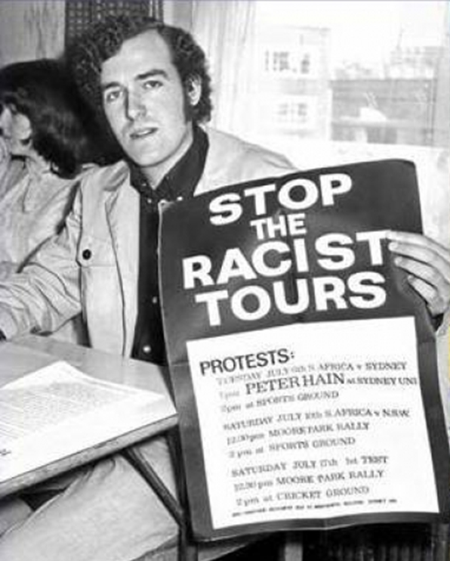
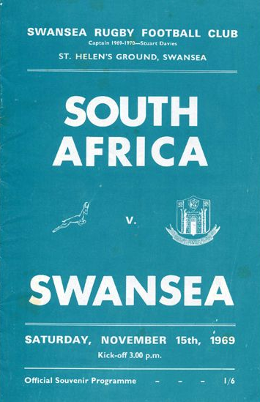
Peter Hain
llun gan:
‎www.liberalhistory.org.uk/wp-
content/uploads/2014/10/74_Spring_2012.pdf
Notes:
Led by Peter Hain, who would later become Lord Hain and a member of parliament for Neath, during the protest in Swansea he was a 19-year-old student and an ardent anti racism campaigner. The world was slowly waking up to the true horror of apartheid regime in South Africa - however rugby was not listening.
"Frankly it was a dialogue with the deaf between anti-apartheid protestors, and players and spectators," said Lord Hain. "We tried to engage with them to say they were collaborators with the most evil and racist system in the world, but they just thought we were interfering with their game - and they really hated us for it."

Slide 7
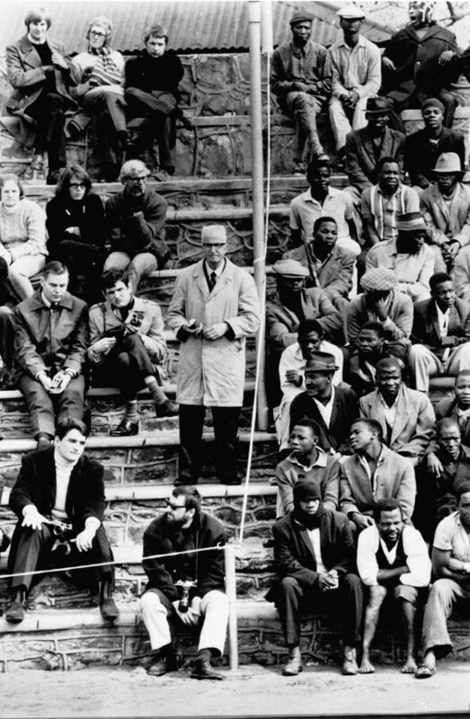
Apartheid yn ne Affrica
Flickr.com: www.unmultimedia.org/photo/

Slide 8
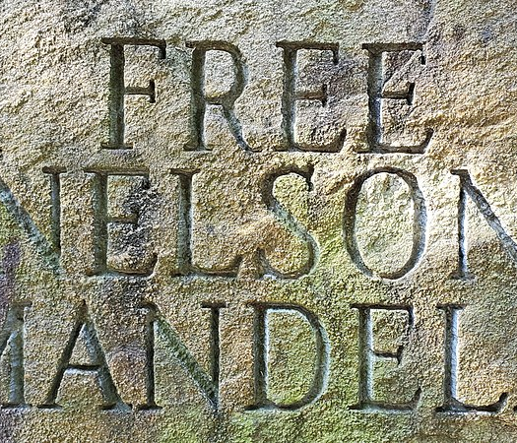
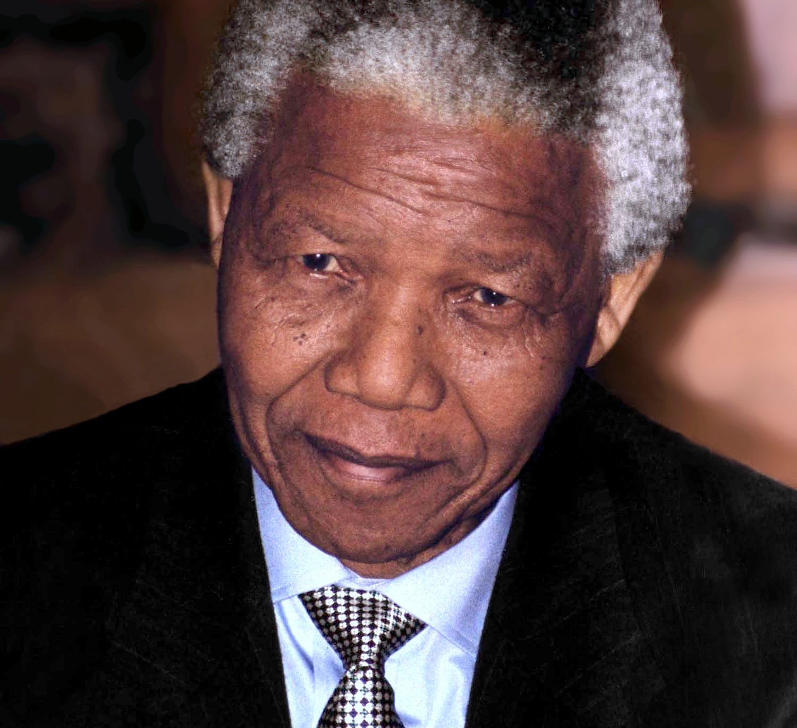
Nelson Mandela

Slide 9
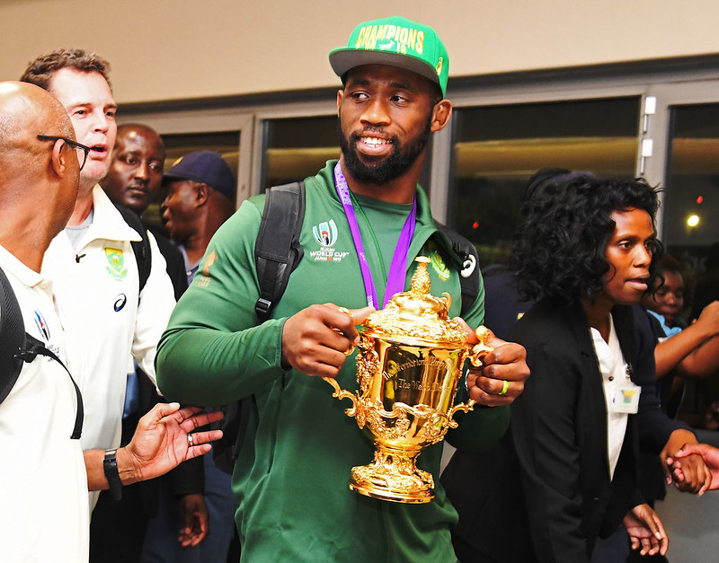
YN 2018, Siya Kolisi OEDD Y DYN DU CYNTAF I’W WNEUD YN GAPTEN tÎm RYGBI’R SPRIngboks. ARWEINIODD DÎm De affrica I FFUDDUGOLIAETH YN rownd derfynol cwpan rygbi’r byd yn erbyn lloegr yn 2019.
Flickr.com: GovernmentZA

Slide 10
Noder bod y deunyddiau hyn wedi’u creu ar y cyd ar gyfer DARPL ac ni ddylid eu defnyddio y tu allan i’r cyd-destun hwn.
Defnyddiwch y nodiadau i athrawon ar y cyd â’r cyflwyniad PowerPoint hwn.
Os oes gennych unrhyw ymholiadau, cysylltwch â darpl@cardiffmet.ac.uk

